Slide 1
Visions of the Future
Kalen Mullin

Slide 2

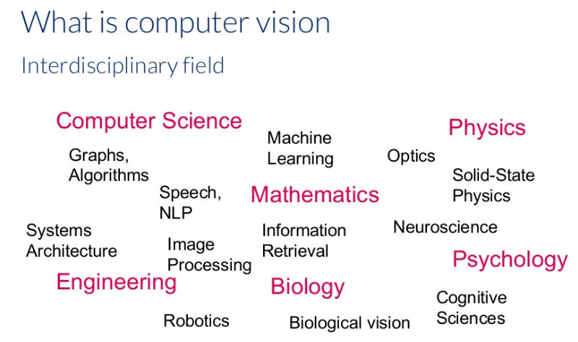
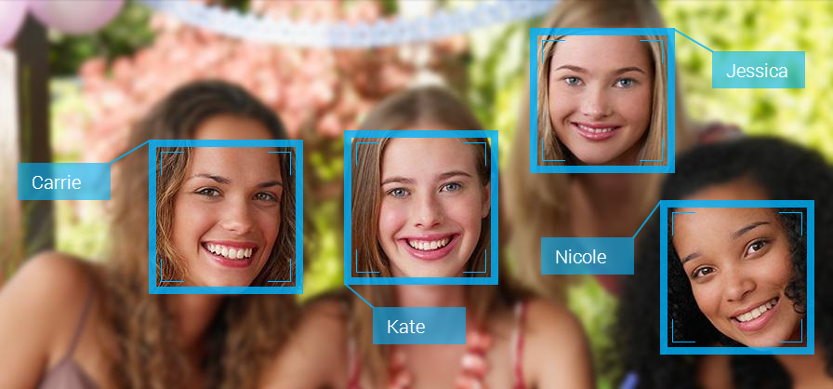
So what is computer vision?

Slide 3
A brief history
Computer vision was founded by Lawrence Robert’s in the 60
The framework for processing was improved by David Marr in 1968
In 1974, Kurzweil Computer Products produced an optical character recognition
Neocognition, developed in 1980 by Dr. Kunihiko Fukushima, allowed for basic object detection
In 2010 ImageNet was released to help further improve training computers on object detection
Following the release of ImageNet, a neural net named AlexNet, was able to achieve a an error rate of only 16.4% which was almost 10% lower than previous networks

Slide 4
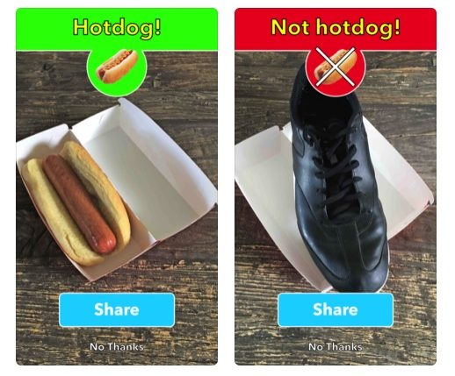
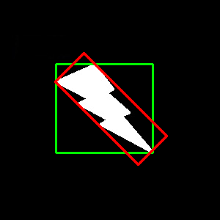
The Basics - Object detection
How does a computer detect an object?
What are some of the different methods for object detection?

Slide 5
The simpler solution
If we want to use the simpler method for object detection by looking at a simple characteristic of the data such as a color we can use some fairly simple mathematical ideas for how it will work. We can construct a simple statement mathematically for how it works, if we assume that a given point x as having our desired characteristic, and we have a function f that maps x to a group of similar points that are connected.
The A in the above equation comes from how we’re constructing the binding object, in this case we are using a box so to put it simply we are looking for the smallest box to cover the largest connected map, and that smallest box becomes our true bounding box, in this case B. Depending on the planned implementation A could be dropped completely and we could just say our boundary is the area of the largest connect map.

Slide 6
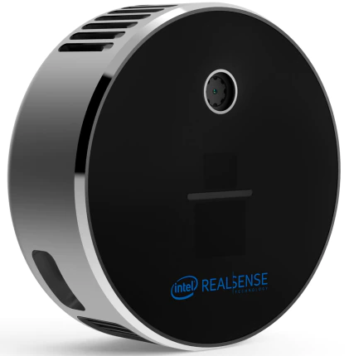
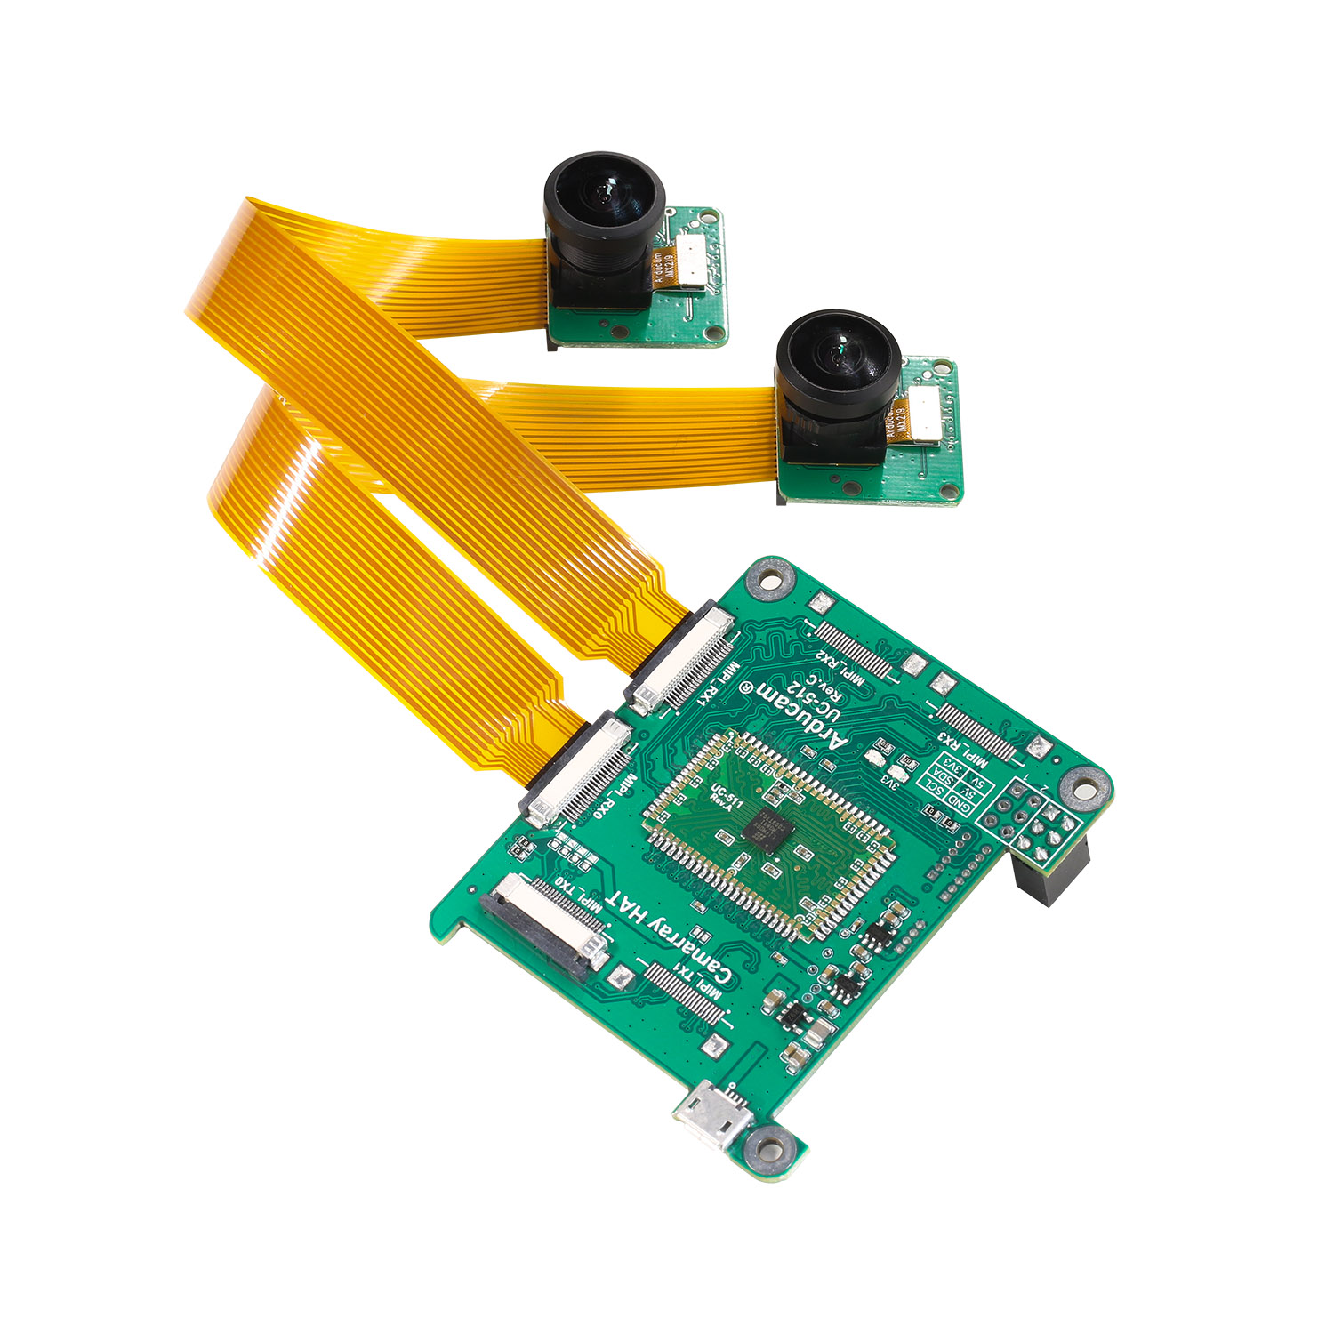
How can we find distances?
There are two methods we can look into for distance
LiDAR - uses a laser to measure distances
Stereoscopic - uses two cameras to measure distance

Slide 7
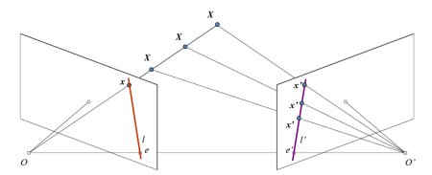
The Basis of Stereo Vision
Stereo vision is calculated with epipole geometry, which has to do with triangulation. Using O and O’ as our cameras, we can pick a point X, which we can form a ray OX along with O’X. For the left camera, any point we pick along the OX ray, x, will appear at the same point that X is at. For the right camera though, the different x points will form a line, l’, that we can search across. The plane created by XOO’ is known as the epipolar plane. The lower points, e and e’, form each cameras epiline, and are their respective cameras epipole, and lie on the line OO’.
Notes:
For a look into the matrix math used in calculating the fundamental look at: https://www.robots.ox.ac.uk/~vgg/hzbook/hzbook1/HZepipolar.pdf

Slide 8
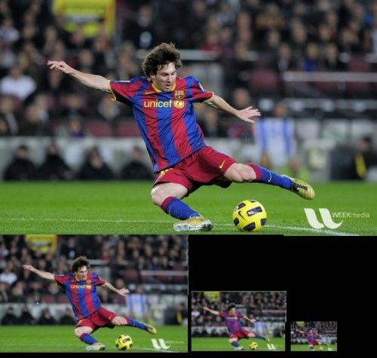
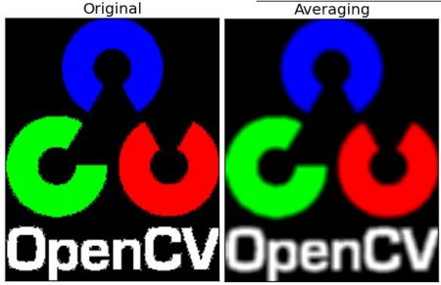
Image Manipulation
Is there anything else that is important in computer vision pass detecting an object and measuring distance?

Slide 9
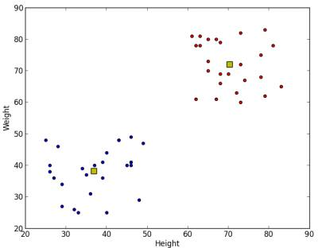
K-means Clustering
A different use is in image segmentation, which uses K-means clustering to manipulate the colors in an image. In this technique we can plot the color of each pixel to a 3d space, and then pick K centroids around the centers of each grouping. We then calculate the squared euclidean distance from every point to every centroid.
After we have found the distance for every single point and centroid, we can then assign each point to a centroid, and then move the centroid to the average of the points it is around. We then repeat the whole process until the centroids are in a stable location

Slide 10
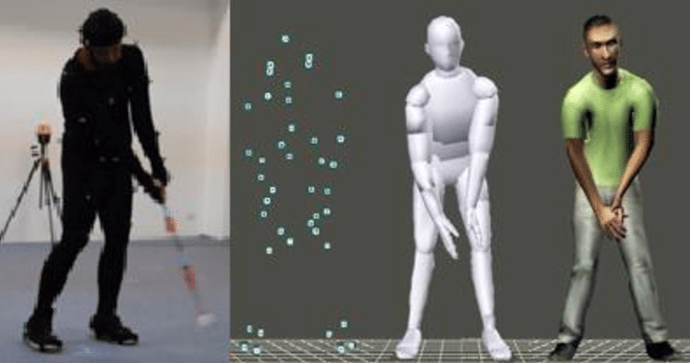
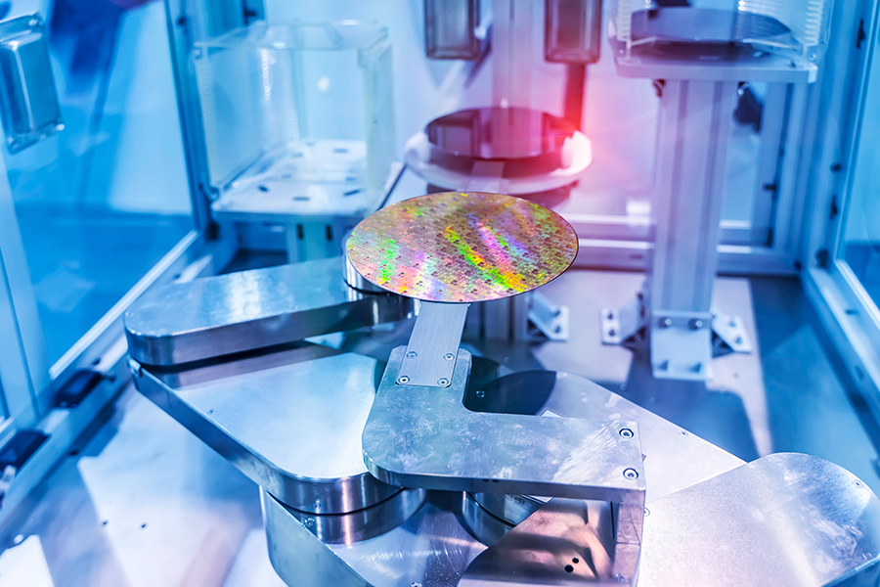
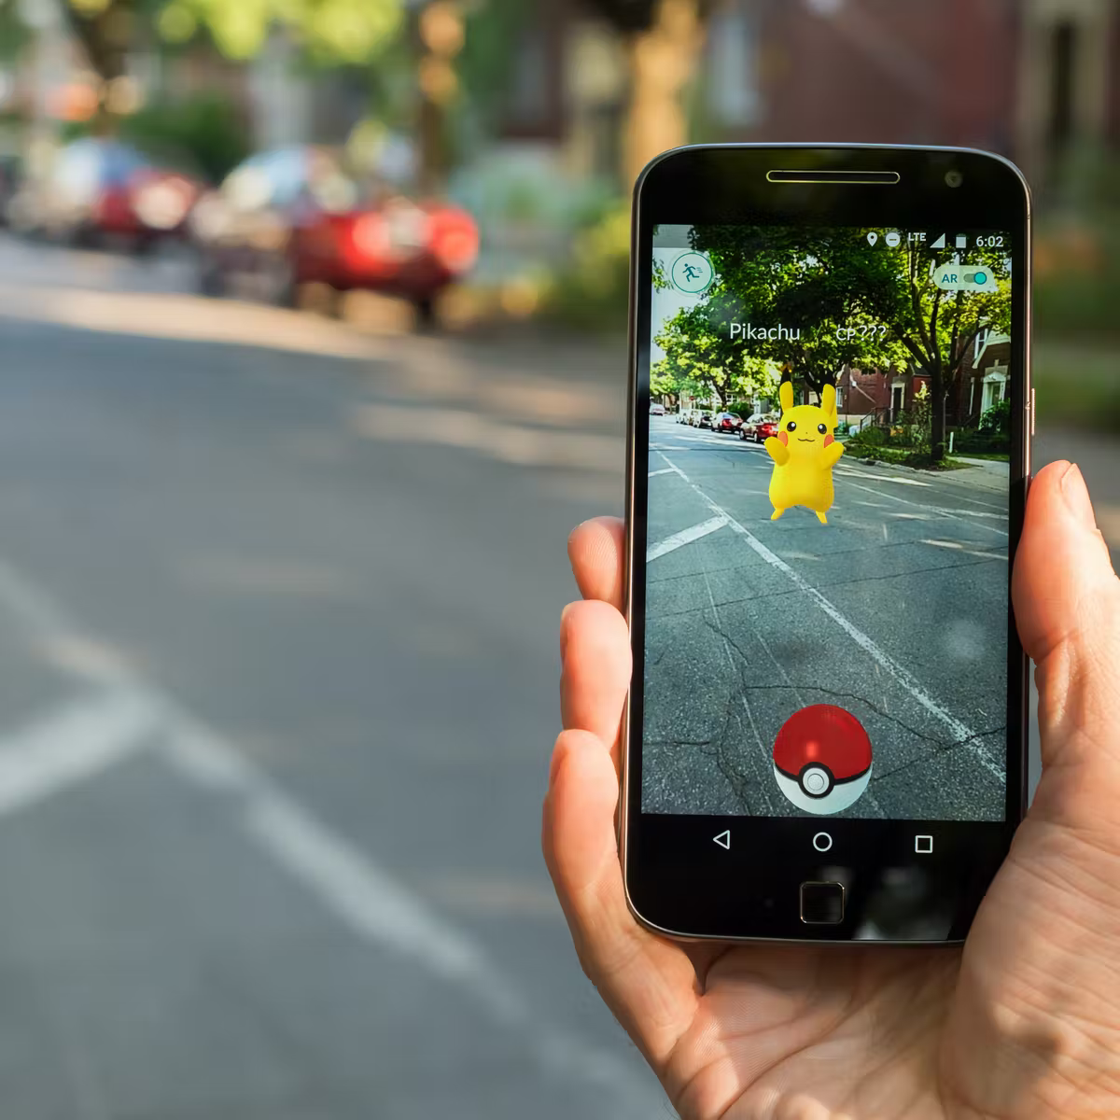
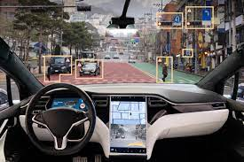
What are the applications of CV?

